Slide 1
Molar Pregnancy and GTN Diagnosis and Management
by: Dr.Maryam Aghdaki GYN Oncology Fellowship

Slide 2
Pelvic ultrasound
Complete mole
Sonographic features suggestive of a complete mole include :
Absence of an embryo or fetus.
Absence of amniotic fluid.
Central heterogeneous mass with numerous discrete anechoic spaces "snowstorm or Swiss cheese pattern"
The sonographic appearance of complete mole is variable. There may be a large, central fluid collection that mimics an anembryonic gestation (missed or incomplete abortion) or a central mass of variable echogenicity without anechoic spaces, presumably because the hydropic villi are too small to visualize sonographically.
Ovarian theca lutein cysts

Slide 3
Pelvic ultrasound
Partial mole
Based upon ultrasound findings, a partial mole is diagnosed as a missed or incomplete abortion in 15 to 60 percent of cases .
Sonographic features suggestive of a partial molar pregnancy include:
A fetus may be identified, may be viable, and is often growth restricted.
Amniotic fluid is present, but the volume may be reduced.
Placenta with one or more abnormal findings – Enlarged, cystic spaces ("Swiss cheese pattern") and/or increased echogenicity of chorionic villi.
Increased transverse diameter of the gestational sac – These changes in the shape of the gestational sac may be part of the embryopathy of triploidy.
Theca lutein cysts are usually absent.

Slide 4
CHOICE OF PROCEDURE FOR REMOVAL OF MOLAR TISSUE
uterine evacuation
hysterectomy:
Signs of trophoblastic proliferation (uterine size greater than gestational age, serum human chorionic gonadotropin [hCG] levels >100,000 milli-international units/mL, ovarian theca lutein cysts >6 cm in diameter).
Age >40 years.
Medication-only methods of uterine evacuation (misoprostol, mifepristone, oxytocin) should not be used , although data are limited.

Slide 5
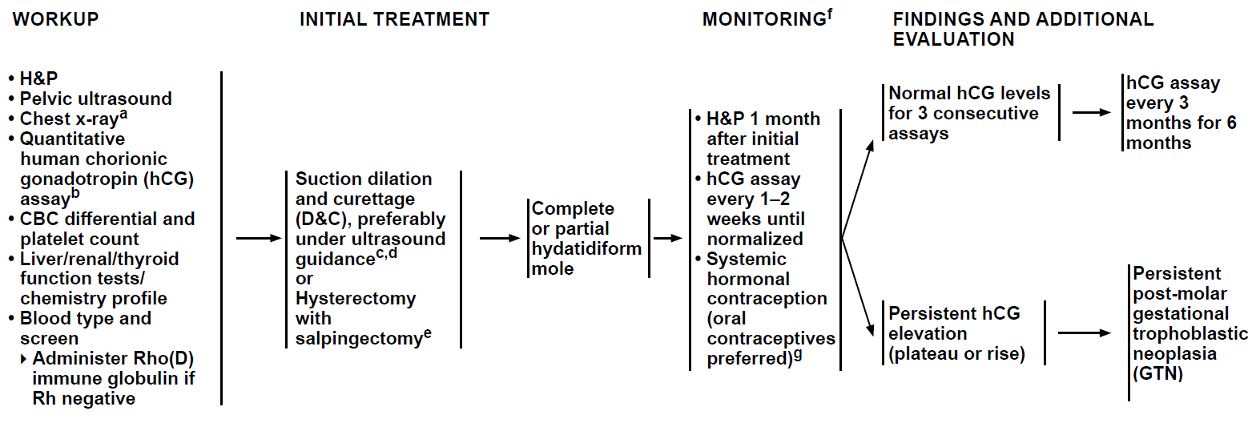
NCCN Guidelines Hydatidiform Mole (Noninvasive)

Slide 6
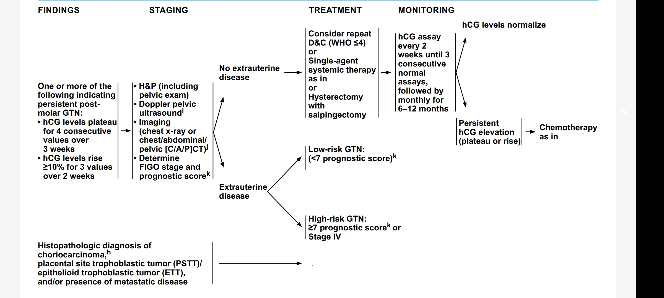
Persistent post molar gtn

Slide 7
USE OF PROPHYLACTIC CHEMOTHERAPY
We only consider it in patients who have complete moles who are at high risk of developing GTN :
they have signs of trophoblastic proliferation, eg. uterine size greater than gestational age, serum human chorionic gonadotropin [hCG] levels >100,000 milli-international units/mL, and ovarian theca lutein cysts >6 cm in diameter,
age >40 years
When hCG follow-up is either unavailable or unreliable.

Slide 8
FIGO STAGING SYSTEM FOR GTN

Slide 9
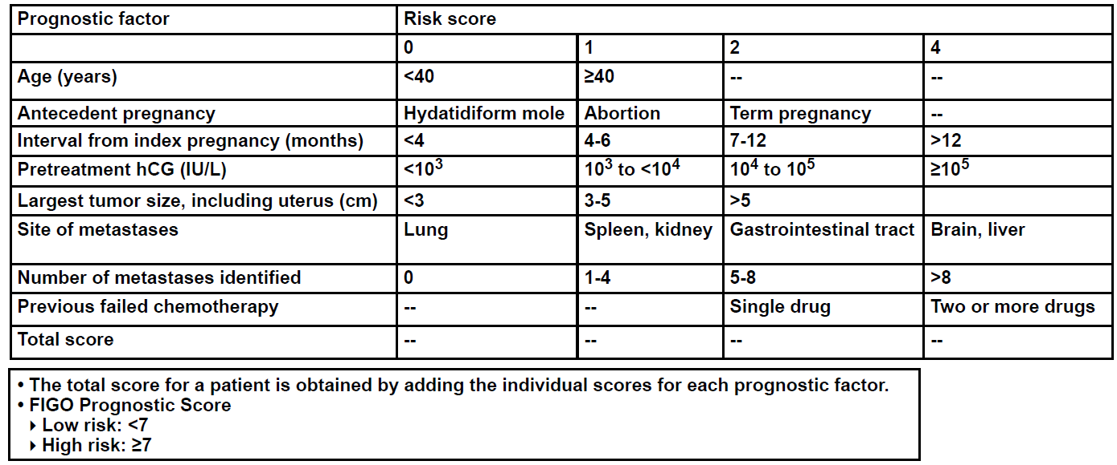
PROGNOSTIC SCORING INDEX FOR GTN

Slide 10
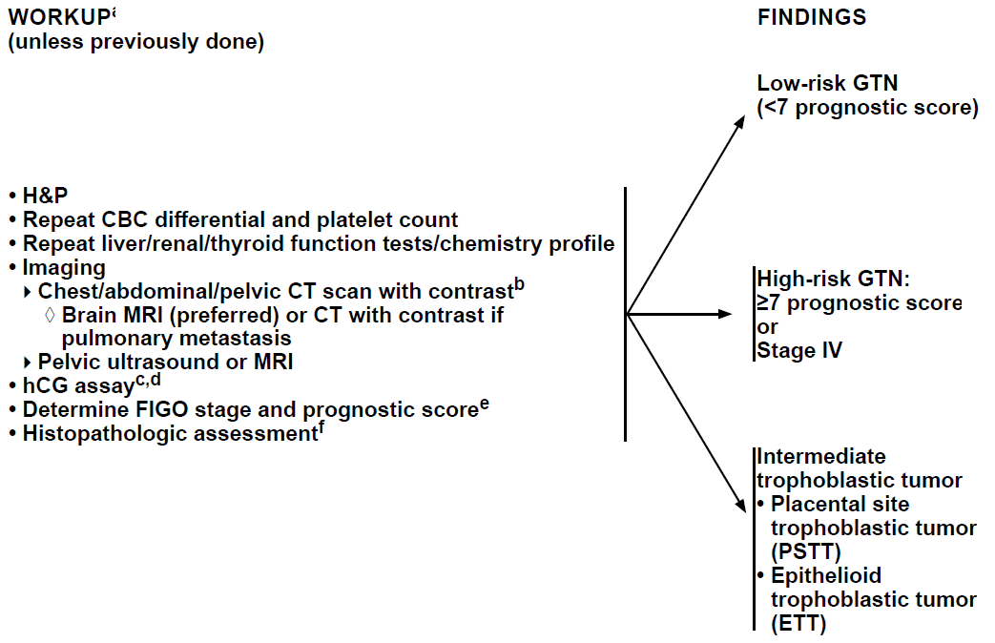
GESTATIONAL TROPHOBLASTIC NEOPLASIA

Slide 11
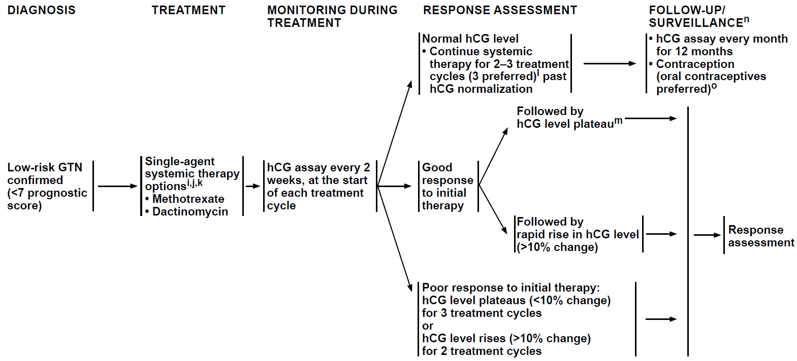
PRIMARY TREATMENT FOR LOW-RISK

Slide 12
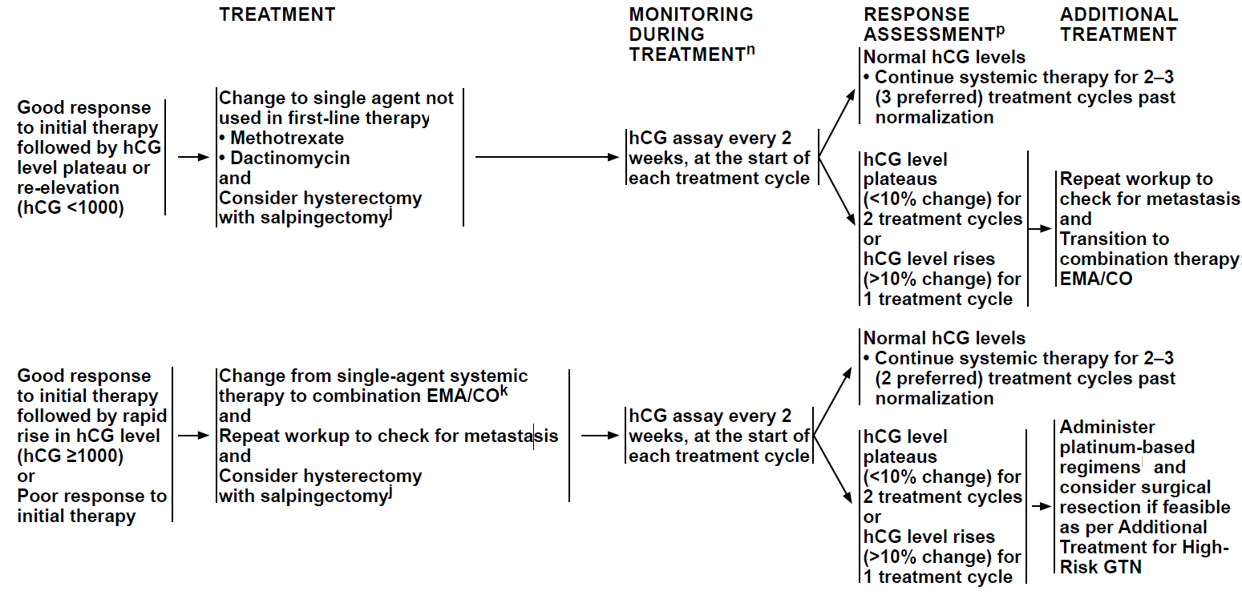
TREATMENT FOR PERSISTENT GTN

Slide 13
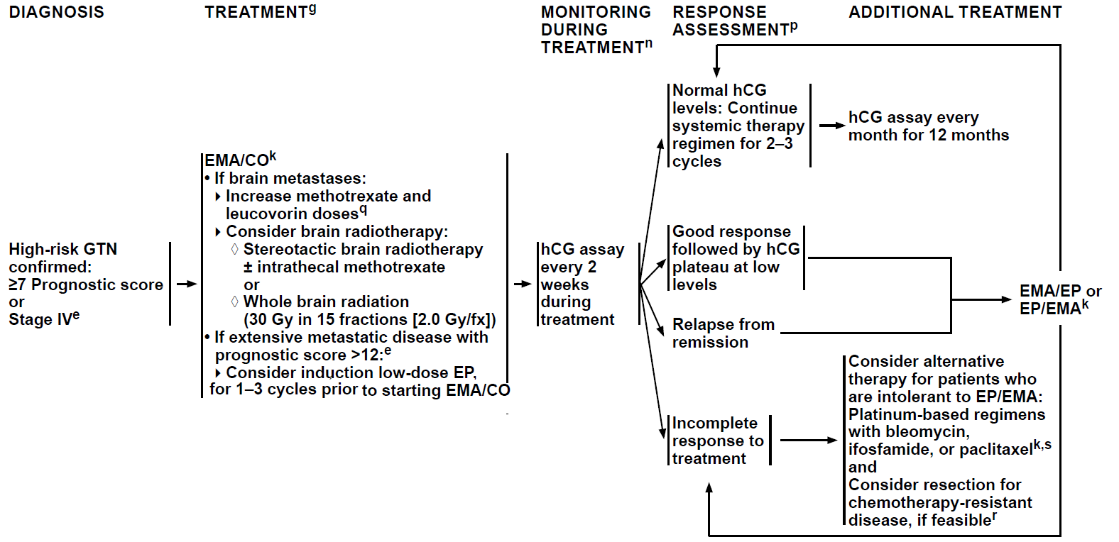
PRIMARY TREATMENT FOR HIGH-RISK GTN

Slide 14
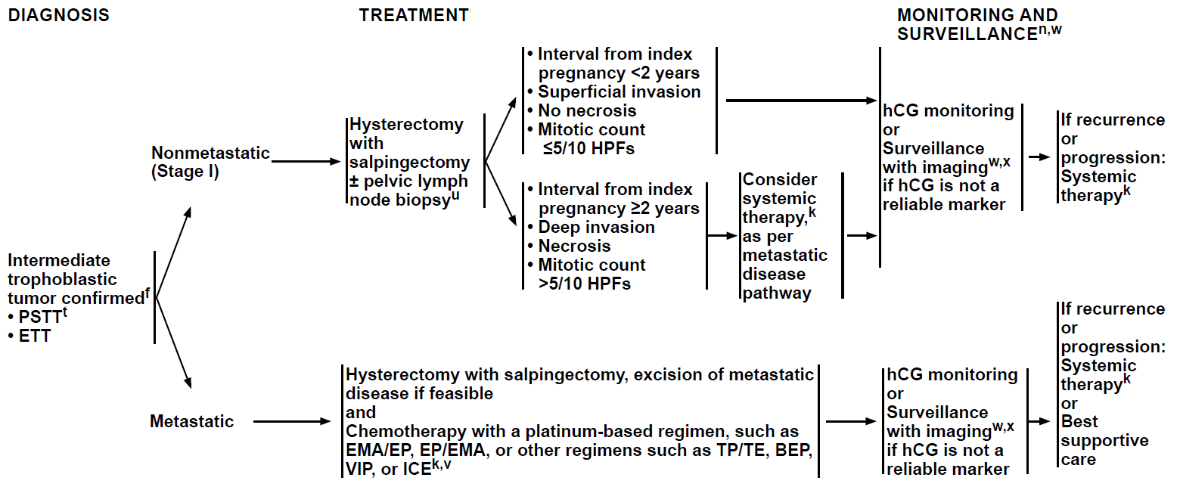
PRIMARY TREATMENT FOR PSTT AND ETT

